Slide 1
Welcome to the European section of Thibaut de Champagne!
M.LARDE
Mrs HEASMAN
M LEMORE
School year 2020-2021

Slide 2
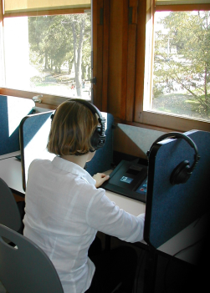
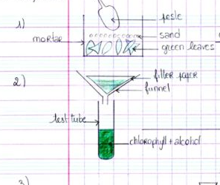
What is a European Section?
European Sections have been created in 1992. Their goal is to promote European and International opening of our schools.
HOW ?
1 hour of English class (reinforcement) with utilization of multimedia material to make easier the oral practising; development of cultural knowledge of the Anglophone world. (more details: M. Lemore)
1 hour of « DNL » which is a Non linguistic class. « SVT » for you. Development of your scientific culture, the scientific method.

Slide 3
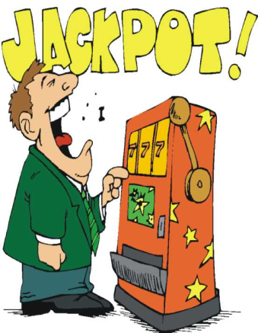
Objectives
Hit the jackpot: obtain your « baccalauréat » with the European distinction (12 at your English exam, 10 at a special exam)
Improve your English in an International world.
Improve your way of thinking by developing your critical mind, comprehension of Science.
Cambridge Test
Make some travels…

Slide 4
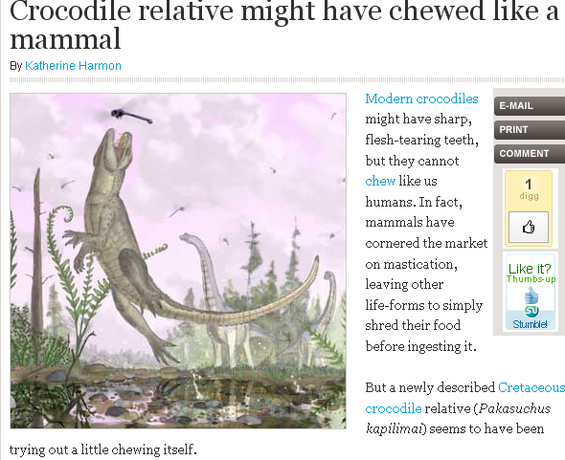
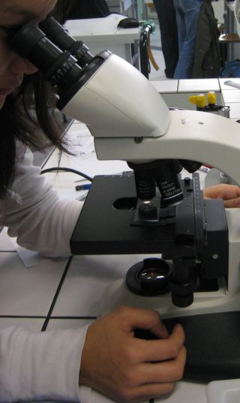
Evaluations:
In English class: see Mr Lemore.
In DNL: pratical activities, work on scientific articles, oral presentation
SVT : Mr Lardé : svtlarde@yahoo.fr

Slide 5
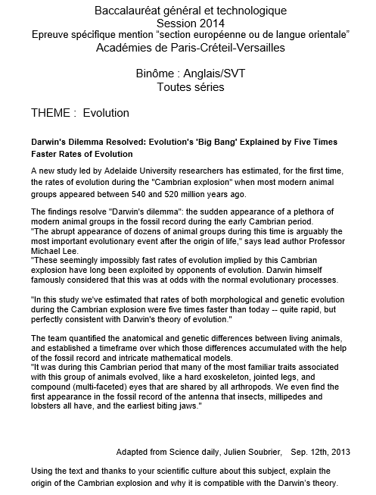
organisation
20 minutes de préparation
20 minutes de passage
Article inconnu (sur un thème travaillé)

Slide 6
oral
Présentation de l’article
explication ou réponse à une question
Description d’un travail réalisé en section
Questions du jury sur article ou travail, voyage

Slide 7
Educational equipment
Usb key
Headphones
Word reference.com

Slide 8
Only one advice for this class:
Don’t be shy!!!!!!!!!!!!

Slide 9
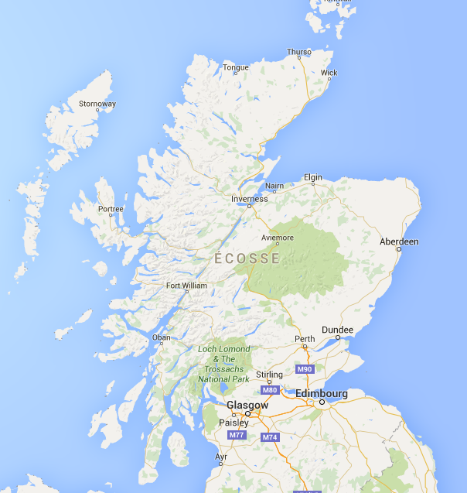
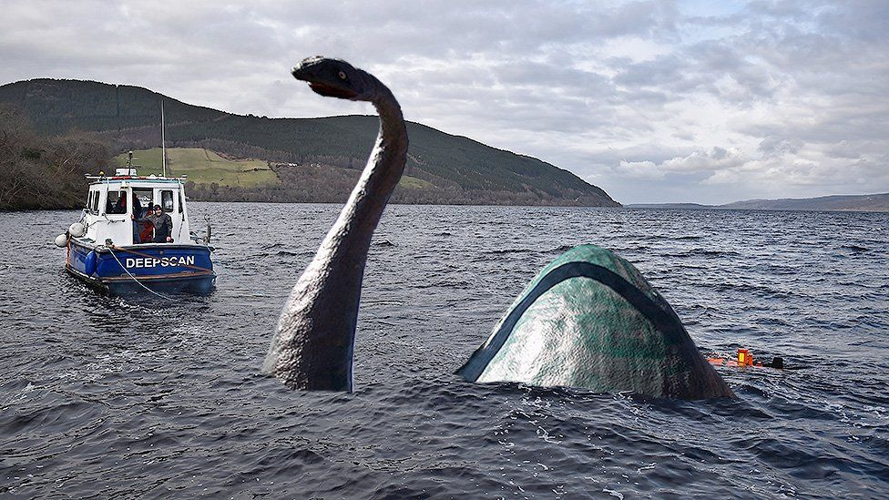
Birthday Scottish TRIP 2021 !!! One time trip for the 10th year of the section

Slide 10
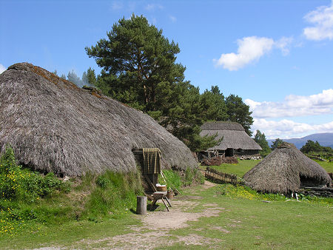
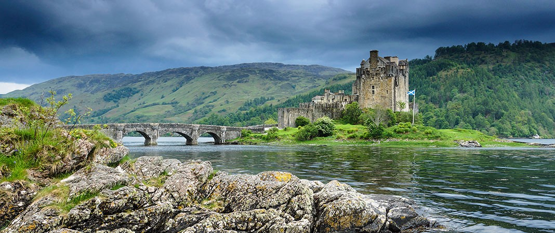
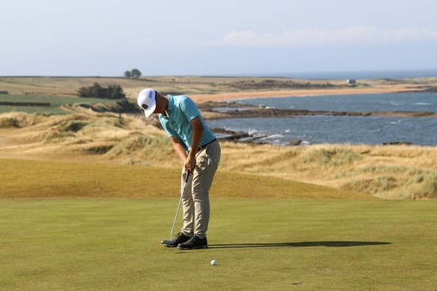
Plan the probable trip to
Scotland!
Culturally
Scientifically
sport

Slide 11
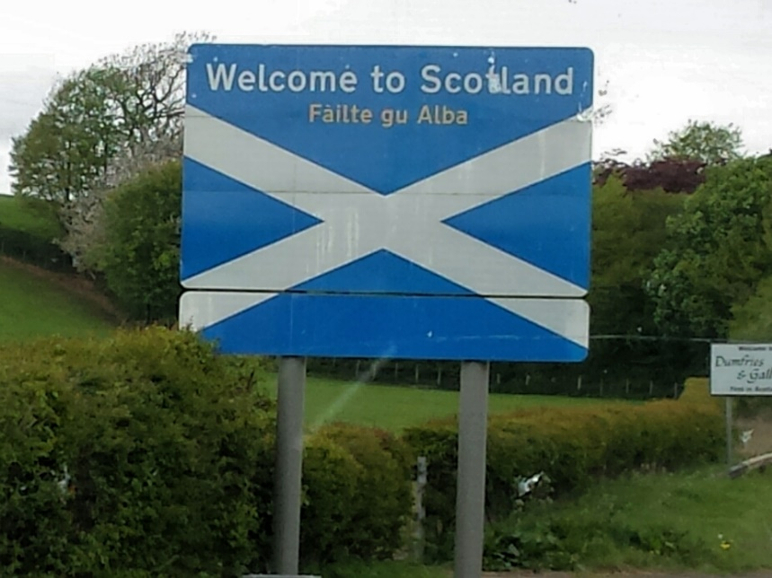
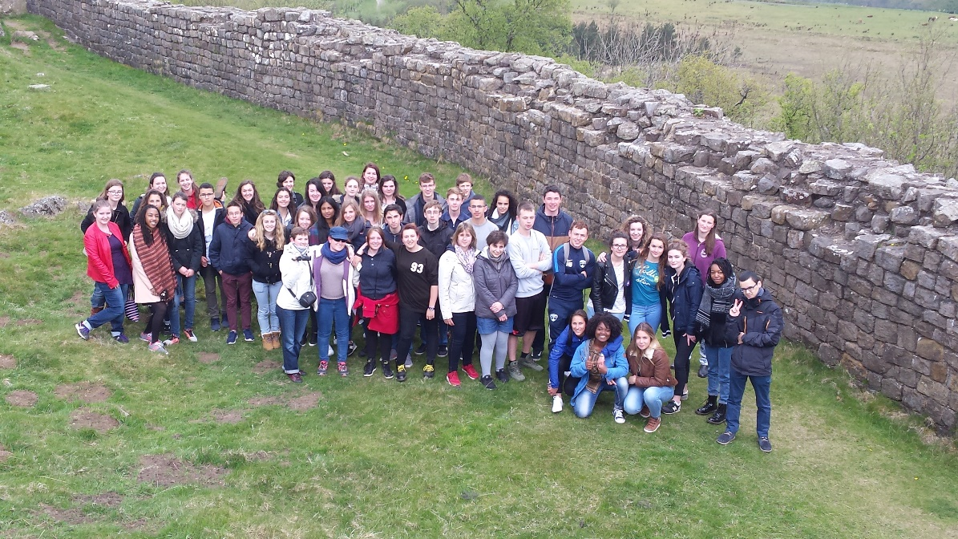
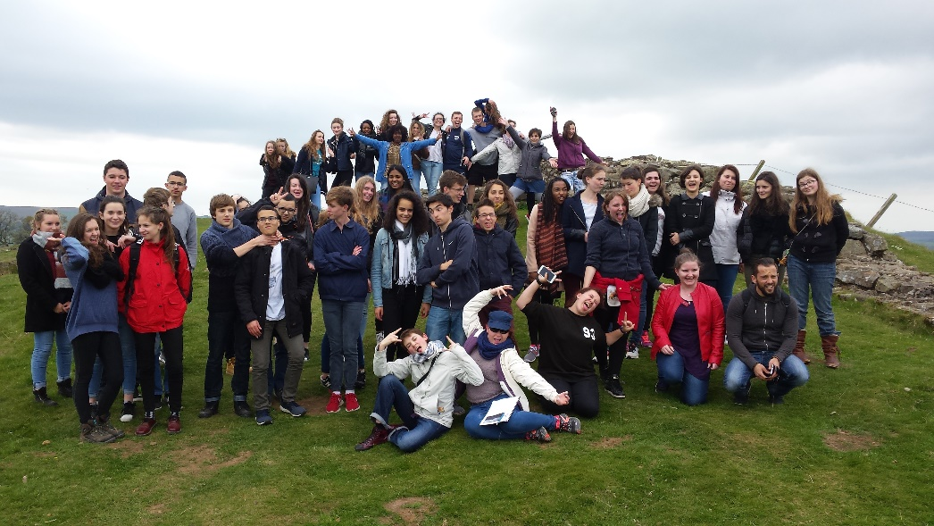

Slide 12
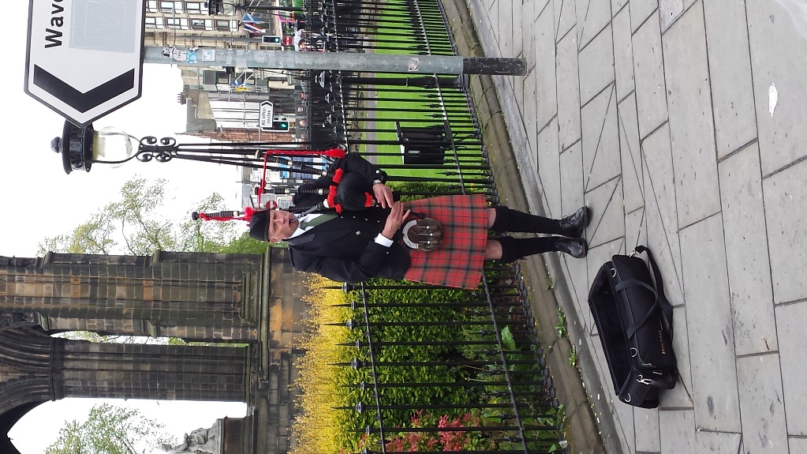
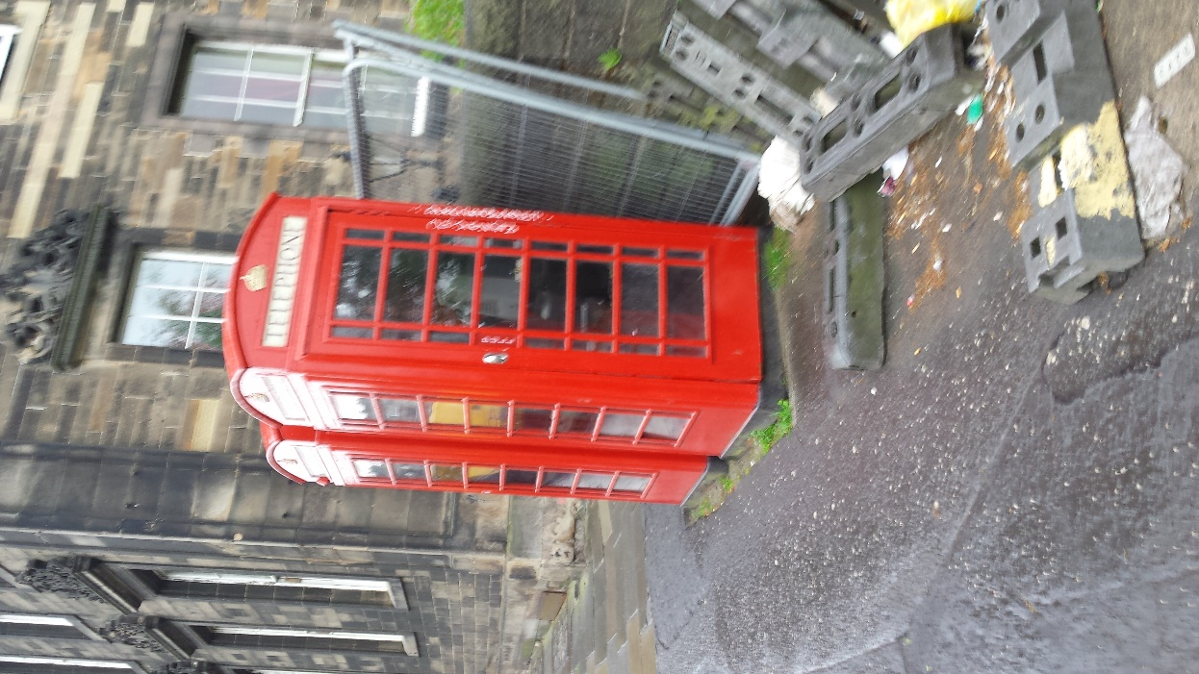
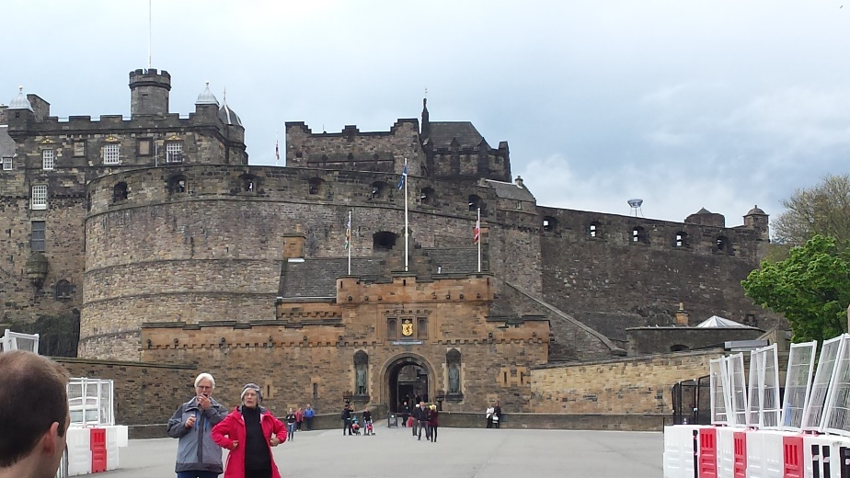

Slide 13
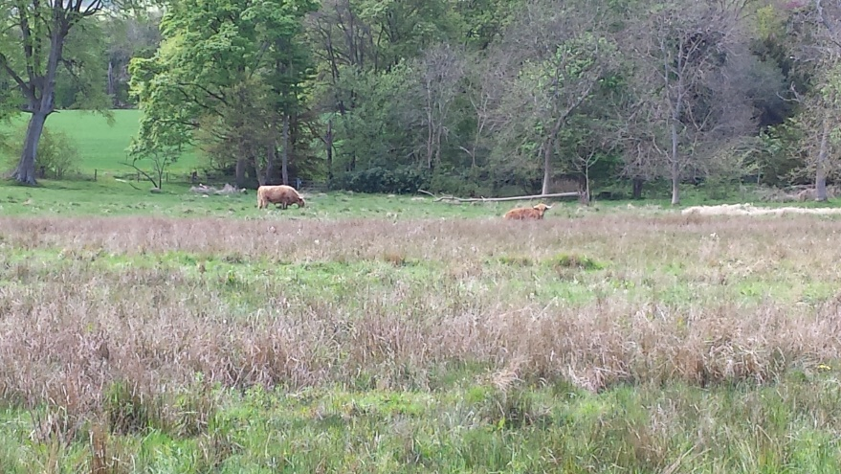
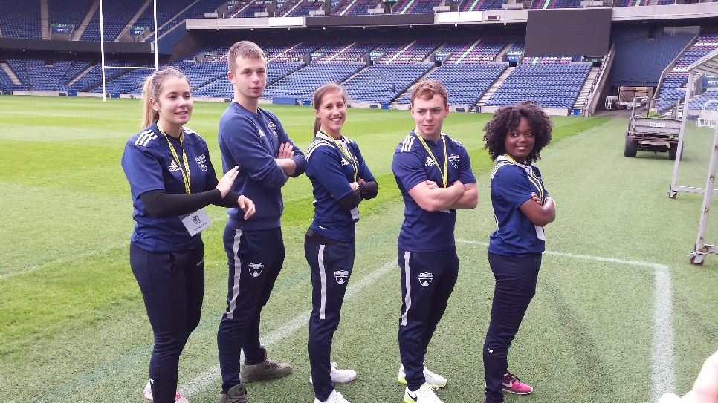
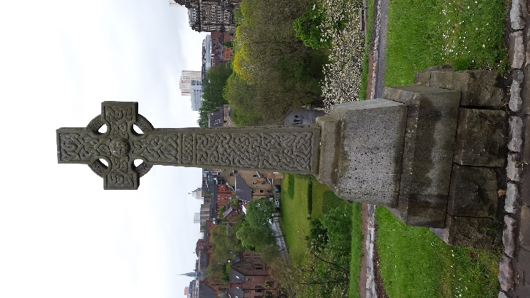
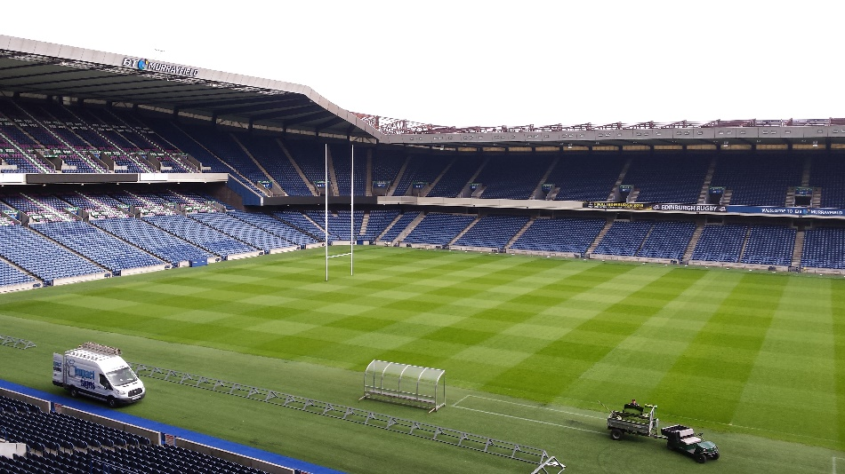

Slide 14
